Slide 1

Sorting Algorithms
Bradley Willcott

Slide 2
Heap Sort Algorithm
Advantages
Θ(n Log n)
Very efficient
Can be in-place
Simpler to understand
Can be used effectively with LinkedLists
Disadvantages
Not stable
Dose not scale-up well with arrays

Slide 3
Merge Sort Algorithm
Advantages
Θ(n Log n)
Works well with large files
Well suited for Linked Lists
Highly parallelizable
Disadvantages
Uses more memory
Arrays and Lists
Not for Linked Lists
Slower in comparison to other algorithms especially for smaller lists

Slide 4
Quick Sort Algorithm
Advantages
Θ(n Log n)
In-place sorting
Very fast, efficient implementations
Disadvantages
O(n²)
Worst case similar to average for Bubble, Insertion or Selection Sorts
Not stable

Slide 5
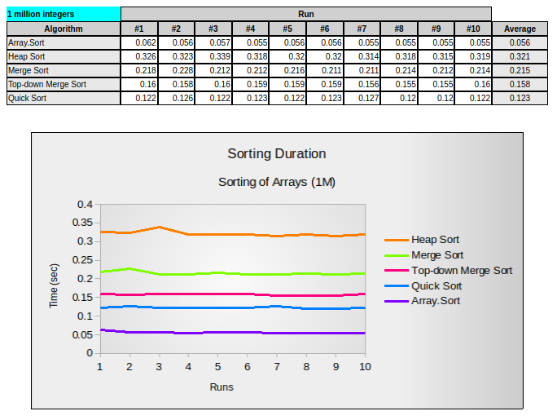
Sorting Duration (1M)
Sorting a list of 1 million integers

Slide 6
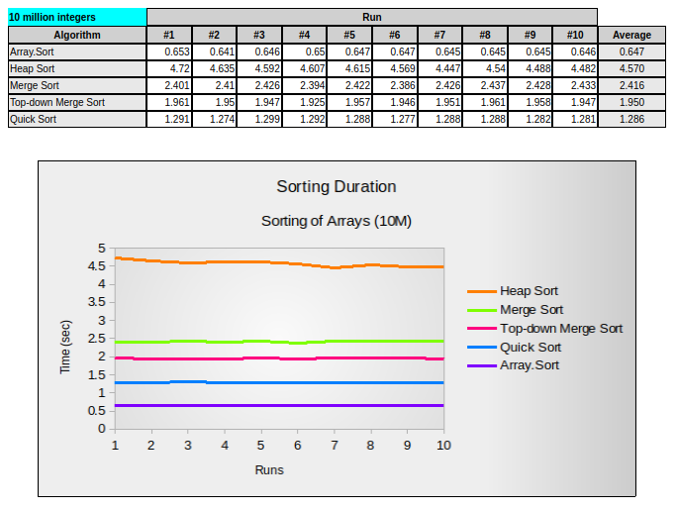
Sorting Duration (10M)
Sorting a list of 10 million integers

Slide 7
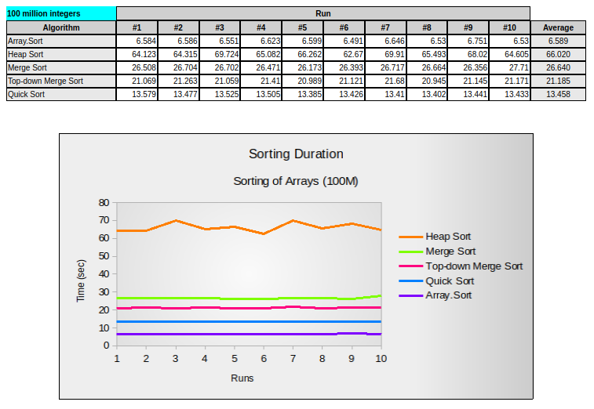
Sorting Duration (100M)
Sorting a list of 100 million integers

Slide 8
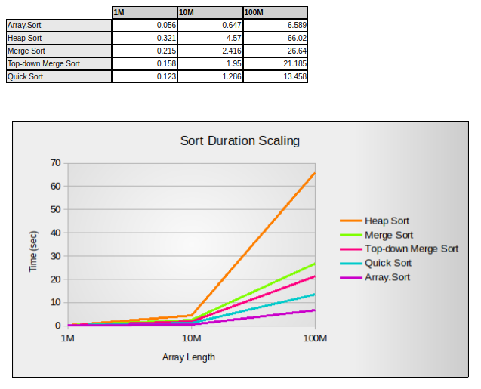
Sort Duration Scaling
Shows the actual average duration times of the sorting algorithms when sorting different sized lists of integers.
This is to show how well, or not, a particular implementation of an algorithm will scale up.

Slide 9
Thank you
Questions
Bradley Willcott

